Slide 1
When will Leaders of Developing Countries Negotiate South-North Preferential Trade Agreements?
Lucie Lu Department of Political Science
University of Illinois at Urbana-Champaign
Notes:
Hi

Slide 2
Outline of Today’s Presentation
Introduction and Research Question
Context and Rationale
Theory: The Logic of Economic Reforms
Research Design
Empirical Findings
Tentative Conclusions
Questions and Comments

Slide 3
Introduction
Case of South Africa in 1994: PTA with EU helped with the economic transition in South Africa
Preferential trade agreements (PTAs) are binding international treaties that help states to foster trade and economic integration among member-states.

Slide 4
Research question
Under what conditions will leaders in the developing countries negotiate the South-North Preferential Trade Agreements with required structural economic reforms?

Slide 5
Research question
Why South-North PTAs?
Power imbalances between two contracting parties
Deliberate choice of leaders: South-North PTAs with the provision of economic reforms are the deepest agreements by design
The puzzles are: What motivates leaders to participate in this costly game?

Slide 6
Context and Rationale
Current literature on the preferential trade agreement mainly focuses on the effects of this institution.
In contrast, explain why states form the PTAs:
The political purposes of the leaders in the developing countries to negotiate trade treaties are currently understudied.

Slide 7
Context and Rationale
Mansfield and Milner (2012): “Government sign PTAs for domestic political reasons” (p. 23).
Voters matter: Democratic countries are more likely to join a PTA than nondemocratic countries (Mansfield & Milner, 2012; Mansfield, Milner, & Rosendorff, 2002).
Interest groups matter: Grossman and Helpman (1995)
Private sectors matter: (Staiger & Tabellini, 1999).

Slide 8
Context and Rationale
How about opposition, those elites from the ruling coalition?
This paper focuses on the strategic behaviors of leaders to form PTAs to consolidate their power vis-à-vis the opposition.

Slide 9
Theory: The Logic of Economic Reforms
Leaders of developing countries: they anticipate a forthcoming structural economic transformation before the negotiation.
Domestic economic reforms usually provoke controversy and organized opposition.
PTA is an effective instrument for promoting such economic reform.
Argument: The leaders in the developing countries choose to negotiate the PTAs to lock in the economic reforms for the primary goal of political survival.

Slide 10
Research Design
Hypothesis:
The presence of shocks to security in a regime is associated with higher probabilities of its leader's PTA negotiation.
(Hypothesized Treatment)
Shock to Leader’s Security
+
South-North PTA Negotiation
Research Design:
Compares the likelihoods of leaders with shocks to security (hypothetical treated group) and without (hypothetical control group) to negotiate the South-North PTAs.

Slide 11
Research Design
Quasi-experiment:
Hypothetical Treatment: Shock to Leaders’ Security
Two indices to measure the security of a leader:
1) A leader's security when he starts his tenure at time 0 depending on his relation to the past leader (or not); and,
2) The security of the regime when the leader holds office at time t.
Two Types of shocks to security:
1) Type 1: a leader is secure at time 0 and becomes insecure immediately onward at time 1 (experiences a shock to security at time 1).
2) Type 2: a leader experiences a shock to security during his tenure a time t.

Slide 12
Examples in Datasets
Unit of analysis: Leader-Year
Coun-try | Ye-ar | Lea-der | Reg-ime | R.T. Past | P. Eff | PTA nego
Albania | 1995 | Berisha | Dem. | NA | 1 | 0
Albania | 1996 | Berisha | Dem. | NA | 1 | 0
Albania | 1997 | Berisha | Dem. | NA | 1 | 0
Albania | 1997 | Fatas | Dem. | NA | 1 | 0
Albania | 1998 | Fatas | Dem. | NA | 2 | 0
Albania | 1999 | Meta | Dem. | NA | 2 | 0
Albania | 2000 | Meta | Dem. | NA | 2 | 0
Albania | 2001 | Meta | Dem. | NA | 2 | 0
Albania | 2002 | Meta | Dem. | NA | 2 | 1
 |  |  | . . .
Algeria | 1995 | Zeroual | Dict. | Regime | 2 | 0
Algeria | 1996 | Zeroual | Dict. | Regime | 2 | 1
Algeria | 1997 | Zeroual | Dict. | Regime | 2 | 0
Algeria | 1998 | Zeroual | Dict. | Regime | 2 | 0
Algeria | 1999 | Zeroual | Dict. | Regime | 2 | 0
Egypt | 2013 | Mansour | Dict. | Opposit-ion | 2 | 0
Egypt | 2014 | Mansour | Dict. | Opposit-ion | 2 | 0
Nambia | 2005 | Pohamb | Dict. | Opposit-ion | 0 | 0
Nambia | . . . | Pohamb | Dict. | Opposit-ion | . . . | . . .
Nambia | 2015 | Pohamb | Dict. | Opposit-ion | 0 | 0
Unit of analysis: Leader
(Main dataset)
e
Cou-ntry | Leader | Te-nure | Reg-ime | R.T. Past | P. Eff | Shock (Z) | PTA nego
Albania | Berisha | 3 | Dem. | NA | ins_all | 0 | 0
Albania | Fatas | 2 | Dem. | NA | shock_t | 1 | 0
Albania | Meta | 4 | Dem. | NA | shock_t1 | 1 | 1
 |  |  | . . .
Algeria | Zeroual | 6 | Dict. | Regime | shock_t1 | 1 | 1
Egypt | Mansour | 2 | Dict. | Opposi-tion | ins_all | 0 | 0
Nambia | Pohamb | 11 | Dict. | Opposi-tion | s_all | 0 | 0

Slide 13
Research Design
Coding Strategies and Justifications:
Unit of analysis is leader. The dataset covers 286 leaders in 62 developing countries in the period 1995 to 2015.
Dependent Variable: South-North PTA negotiation
Independent Variable: Shocks to Security
Matching on the Covariates: Regime Type, Human Rights Conditions, Regime Duration, GDP per capita
Confounding Variables in the OLS Model:
Leaders’ tenure
Economic Recession (Negative Economic Growth)

Slide 14
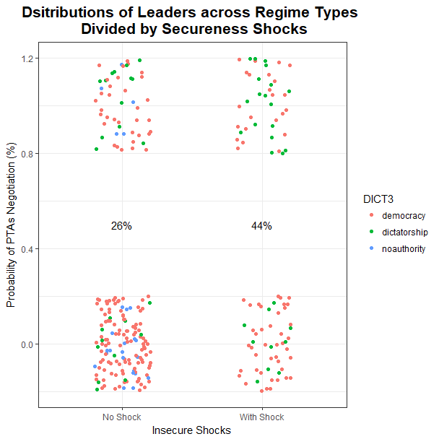
Empirical Findings: Data Description

Slide 15
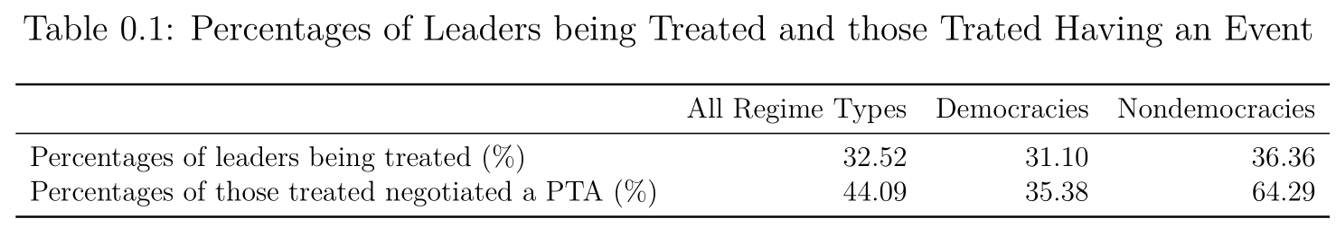
Empirical Findings: Data Description

Slide 16
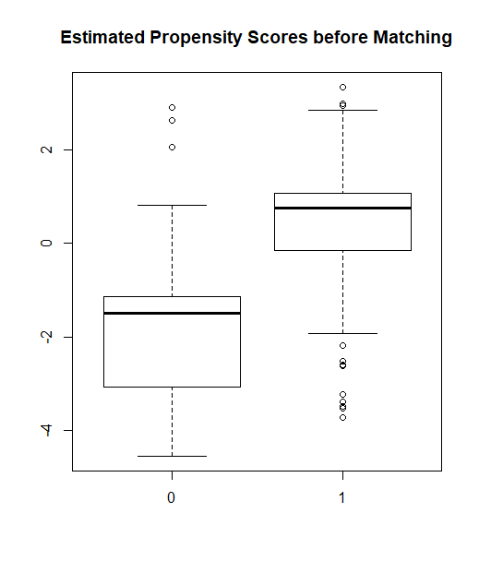
Empirical Findings: Propensity Score Before Matching
The estimated propensity scores are the fitted probabilities of being treated given four covariates.
The difference between two distributions are substantial.

Slide 17
Empirical Findings: Propensity Score After Matching

Slide 18
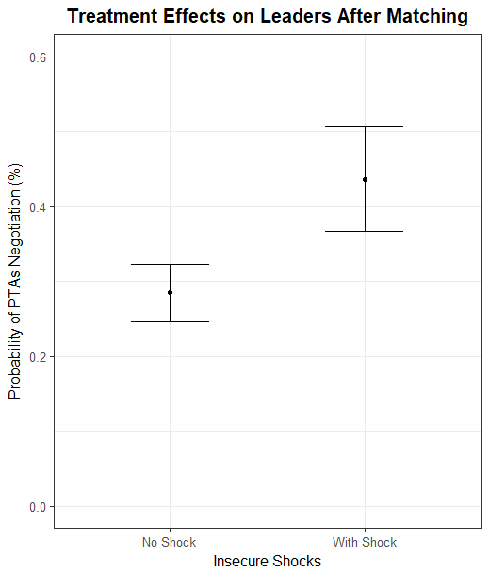
Empirical Findings: Treatment Effect After Matching
Holding leaders’ mean tenure constant, when there is no economic recession, those leaders who have experienced insecure shocks on average have 15% higher probability to negotiate a PTA than those without such “treatment”.

Slide 19
Preliminary Conclusions
My hypothesis is empirically supported:
When leaders experience political crisis, they are more likely to negotiate a South-North preferential trade agreement with the provision of economic reforms.
Moving forward:
Explore whether PTA negotiation helps leaders to conduct economic reforms.
Notes:
hello

Slide 20
Questions and Comments are Greatly Appreciated! Thank you very much.

